Slide 1



Noida Institute of Engineering and Technology, Greater Noida
ARM ARCHITECTURE FOR IoT
UNIT-II
OVERVIEW OF CORTEX- M0+
Dr. Zatin Gupta
Associate Professor
B. Tech Fifth Semester
(Internet On Things)

Slide 2
Index
Course Outcomes
Syllabus
Contents of the Unit
Objectives of the Unit
CO- PO correlation w.r.t. Unit
CO-PSO correlation w.r.t. Unit
Prerequisite and Recap
Objectives of the topic
Topic mapping with CO
Video Links
Daily Quiz
MCQs
Weekly assignment
Old University Exam Paper
Expected Questions for University Exams
Summary
References

Slide 3
Program Outcomes
1. Engineering knowledge: Apply the knowledge of mathematics, science, engineering fundamentals, and an engineering specialization for the solution of complex engineering problems.
2. Problem analysis: Identify, formulate, research literature, and analyse complex engineering problems reaching substantiated conclusions using first principles of mathematics, natural sciences, and engineering sciences.
3. Design/development of solutions: Design solutions for complex engineering problems and design system components or processes that meet the specified needs with appropriate consideration for public health and safety, and cultural, societal, and environmental considerations.
4. Conduct investigations of complex problems: Use research-based knowledge and research methods including design of experiments, analysis and interpretation of data, and synthesis of information to provide valid conclusions.
5. Modern tool usage: Create, select, and apply appropriate techniques, resources, and modern engineering and IT tools, including prediction and modeling to complex engineering activities, with an understanding of the limitations.
6. The engineer and society: Apply reasoning informed by the contextual knowledge to assess societal, health, safety, legal and cultural issues and the consequent responsibilities relevant to the professional engineering practice.
7. Environment and sustainability: Understand the impact of the professional engineering solutions in societal and environmental contexts, and demonstrate the knowledge of, and need for sustainable development.
8. Ethics: Apply ethical principles and commit to professional ethics and responsibilities and norms of the engineering practice.
9. Individual and team work: Function effectively as an individual, and as a member or leader in diverse teams, and in multidisciplinary settings.
10. Communication: Communicate effectively on complex engineering activities with the engineering community and with the society at large, such as, being able to comprehend and write effective reports and design documentation, make effective presentations, and give and receive clear instructions.
11. Project management and finance: Demonstrate knowledge and understanding of the engineering and management principles and apply these to one’s own work, as a member and leader in a team, to manage projects and in multidisciplinary environments.
12. Life-long learning: Recognize the need for, and have the preparation and ability to engage in independent and life-long learning in the broadest context of technological change.

Slide 4
Course Outcome
Course outcome: After completion of this course students will be able to
CO 1 | Describe ARM processor architectures. | K₁, K₂
CO 2 | Recognize ARM-based microcontrollers as modern IoT computing platforms. | K₁, K_{3,}
CO 3 | Realize Software design basics, software engineering principles. | K_{3,} K₄
CO4 | Explore Target Board FRDM-KL25Z for embedded system application. | K_{3,} K₄
CO 5 | Design smart IoT enabled devices using ARM. | K₂, K_{4,} K₅

Slide 5
ARM ARCHITECTURE FOR IoT |  |  |  |  |  |  |  |  | Year of Study: 2022-21
CO | PO1 | PO2 | PO3 | PO4 | PO5 | PO6 | PO7 | PO8 | PO9 | PO10 | PO11 | PO12
CO1 | 3 | 1 |  | 1 | 0 | 1 | 0 | 0 | 0 | 0 | 0 | 2
CO2 | 3 | 2 | 1 | 2 | 1 | 0 | 1 | 0 | 0 | 0 | 0 | 1
CO3 | 3 | 3 | 3 | 2 | 3 | 1 | 1 | 0 | 0 | 0 | 0 | 2
CO4 | 3 | 2 | 3 | 2 | 3 | 1 | 1 | 0 | 0 | 0 | 0 | 2
CO5 | 3 | 3 | 3 | 3 | 3 | 1 | 1 | 0 | 0 | 0 | 0 | 2
Average | 3 | 2.2 | 2.5 | 2 | 2 | 0.8 | 0.8 | 0 | 0 | 0 | 0 | 1.8

Slide 6
Syllabus
ARM Architecture Processor: Introduction,
ARM Processor Families,
ARM Cortex-M Series,
ARM Processor vs. ARM Architectures.
Overview of Cortex-M0+ Block Diagram, Registers, Processor Memory Map,
Instruction Sets: ARM and Thumb Instruction Set,
Cortex-M0+ Instruction Set,
Program Code in Assembly Language,
Program Code in C Language.
Program-Generation Flow,
Cortex-M0+ Program Image,
Program Data,
how is Data Stored in RAM, Data Types.

Slide 7
ARM
The ARM processor core is a key component of many successful 32-bit embedded systems.
The ARM company bases their success on a simple and powerful original design, which continues to improve today through constant technical innovation. In fact, the ARM core is not a single core, but a whole family of designs sharing similar design principles and a common instruction set.
The ARM core uses a RISC architecture. RISC is a design philosophy aimed at delivering simple but powerful instructions that execute within a single cycle at a high clock speed.

Slide 8
Characteristics of ARM processor
Instructions—RISC processors have a reduced number of instruction classes. These classes provide simple operations that can each execute in a single cycle. ach instruction is a fixed length to allow the pipeline to fetch future instructions before decoding the current instruction. In contrast, in CISC processors the instructions are often of variable size and take many cycles to execute.
Pipelines—The processing of instructions is broken down into smaller units that can be executed in parallel by pipelines. Ideally the pipeline advances by one step on each cycle for maximum throughput. Instructions can be decoded in one pipeline stage. There is no need for an instruction to be executed by a miniprogram called microcode as on CISC processors.

Slide 9
Characteristics of ARM processor
Registers—RISC machines have a large general-purpose register set. Any register can contain either data or an address. Registers act as the fast local memory store for all data processing operations. In contrast, CISC processors have dedicated registers for specific purposes.
Load-store architecture—The processor operates on data held in registers. Separate load and store instructions transfer data between the register bank and external memory. Memory accesses are costly, so separating memory accesses from data processing provides an advantage because you can use data items held in the register bank multiple times without needing multiple memory accesses. In contrast, with a CISC design the data processing operations can act on memory directly.

Slide 10
ARM-based embedded device

Slide 11
ARM-based embedded device
The ARM processor controls the embedded device. Different versions of the ARM processor are available to suit the desired operating characteristics. An ARM processor comprises a core (the execution engine that processes instructions and manipulates data) plus the surrounding components that interface it with a bus. These components can include memory management and caches.
Controllers coordinate important functional blocks of the system. Two commonly found controllers are interrupt and memory controllers.
The peripherals provide all the input-output capability external to the chip and are responsible for the uniqueness of the embedded device.
A bus is used to communicate between different parts of the device.

Slide 12
Advanced Microprocessor Bus Architecture (AMBA) Bus Protocol
The first AMBA buses introduced were the ARM System Bus (ASB) and the ARM Peripheral Bus (APB). Later ARM introduced another bus design, called the ARM High Performance Bus (AHB).
Advanced Microcontroller Bus Architecture (AMBA) is a freely available, open standard for the connection and management of functional blocks in a System-on-Chip (SoC).
AHB/ASB used for interconnection high speed devices.
APB is used for interconnecting slow devices.
Bridge is used for protocol conversion.

Slide 13
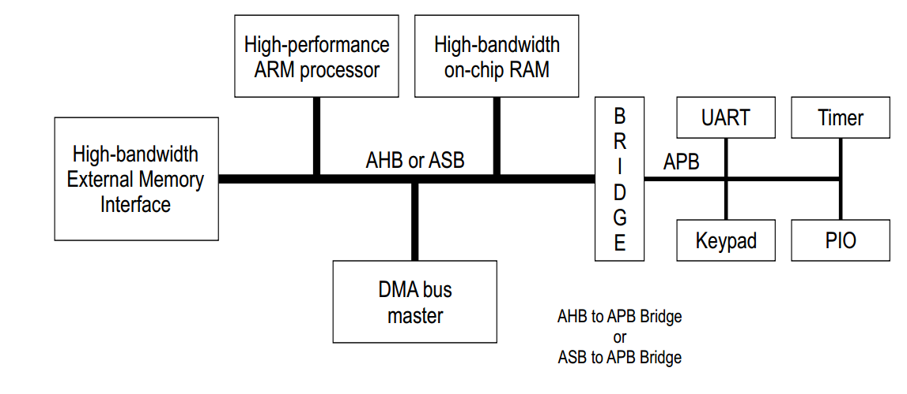
Advanced Microcontroller Bus Architecture (AMBA) Bus Protocol

Slide 14
Memory trade-off
An embedded system has to have some form of memory to store and execute code. You have to compare price, performance, and power consumption when deciding upon specific memory characteristics, such as hierarchy, width, and type. If memory has to run twice as fast to maintain a desired bandwidth, then the memory power requirement may be higher.
Storage trade-offs.

Slide 15
Memory interfacing capability and ARM processor Modes
 | 8-bit memory | 16-bit memory | 32-bit memory
ARM 32-bit (Instruction size 32 bit) | 4 cycle | 2 cycle | 1 cycle
ARM 16-bit (Instruction size 16 bit/ Thumb mode) | 2 cycle | 1 cycle | 1 cycle
ARM 8-bit (Instruction size 8 bit/ Jazelle mode) | 1 cycle | 1 cycle | 1 cycle

Slide 16
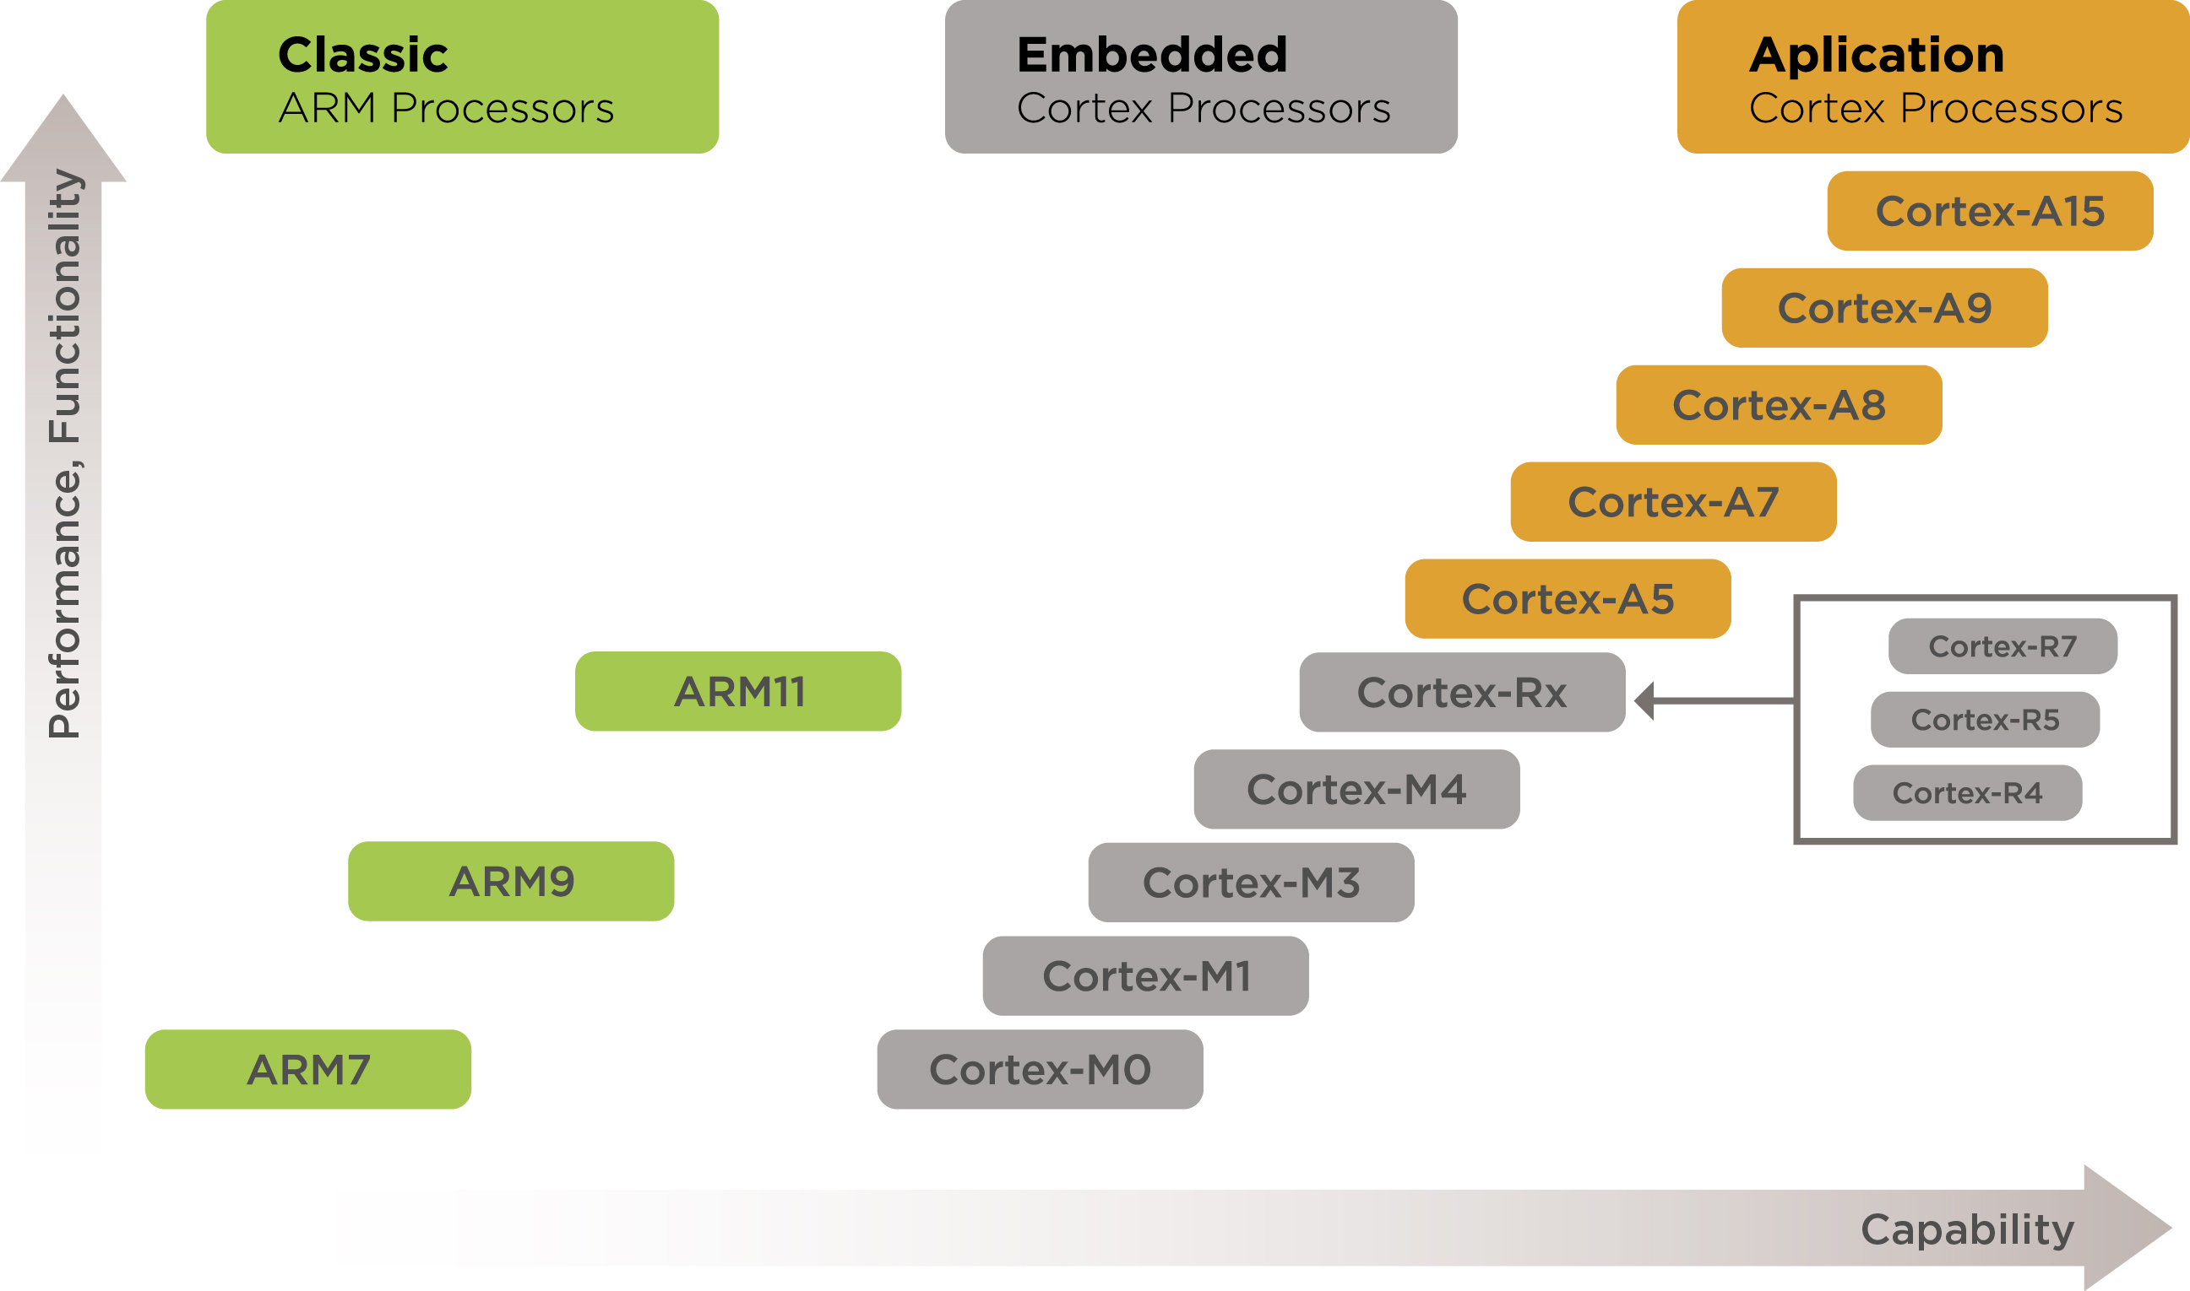
ARM Family

Slide 17
Types of ARM
ARM solutions are dedicated to the needs of:
system-on-chips architecture-built products
system-on-modules architecture-built products.
ARM Holdings offers users the following types of processors:
Cortex-A: built for advanced operating systems and exhibits the highest possible performance;
Cortex-R: caters perfectly to the needs of real-time applications and provides its users with the fastest response times;
Cortex-M: mainly built for microcontrollers;

Slide 18
ARM Cortex-A
Cortex-A: The Cortex-A category of processors is dedicated to Linux and Android devices. Any devices – starting from smartwatches and tablets and continuing with networking equipment – can be supported by Cortex-A processors.
Some technical information:
The ARM-7 architecture forms the basis of the A5, A7, A8, A9, A12, A15, and A17 processors;
A5: The Cortex A5 is the smallest processor of the A-range.
A7: The performance provided by the A7 is 20% higher. The Cortex-A7 finds its application in smartphones and tablets and is famous for its power optimization technology.
A15: This is the first processor in the range that fits data management and virtual environment solutions.
A17: The processor can be configured with 1–4 cores with out-of-order pipelines.
A50: The Cortex-A50 processor extends the areas of application to low-power servers. It demonstrates useful power-optimized features and creates great conditions for the migration of 64-bit operating systems to mobile solutions.
ARM Cortex-A processors better than their applications and potential usage:
Smart Devices and Wearables;
Automotive Systems;
Servers & Networks;
Satellite Receivers;
Home Gateways;
One of the most famous companies that use ARM Cortex-A processors is Apple.

Slide 19
ARM Cortex-R
Cortex-R processors primarily target real-time solutions. They find application in controllers, networking equipment, media players, and other similar devices. Furthermore, this type of ARM processor provides great support for the automotive industry.

Slide 20
ARM: Cortex-M
The point of interest of Cortex-M processors is the MCU and Embedded system and IoT market. The ARM processors of this type find their implementation in FPGA, integrated memories, clocks, etc. Different members of the set have different improved features: some of them demonstrate higher performance, others are more energy efficient.
ARM Cortex M0+: This kind of processor shows rather low performance. It uses the Thumb-2 instruction set and has a 2-stage pipeline. Significant features are the bus for single-cycle GPIO and the micro trace buffer. The Cortex-M0+ is a level up from an 8-bit MCU. With this processor, bug fixing gets easier.
Application: Pen Drive uses ARM Cortex M0+. Smart Lighting; Motion Sense Devices;

Slide 21
ARM Cortex-M Series
M3 & M4: both provide 1.25 DMIPS/MHz the difference between M3 and M4 is that the core of M4 is capable of DSP.
The areas of application of M-category ARM processors are:
Smartwatches;
Automotive, Retail & Healthcare Industries;
Energy Grids.
Fitbit and Samsung both use ARM Cortex-M controllers in their smartwatches

Slide 22
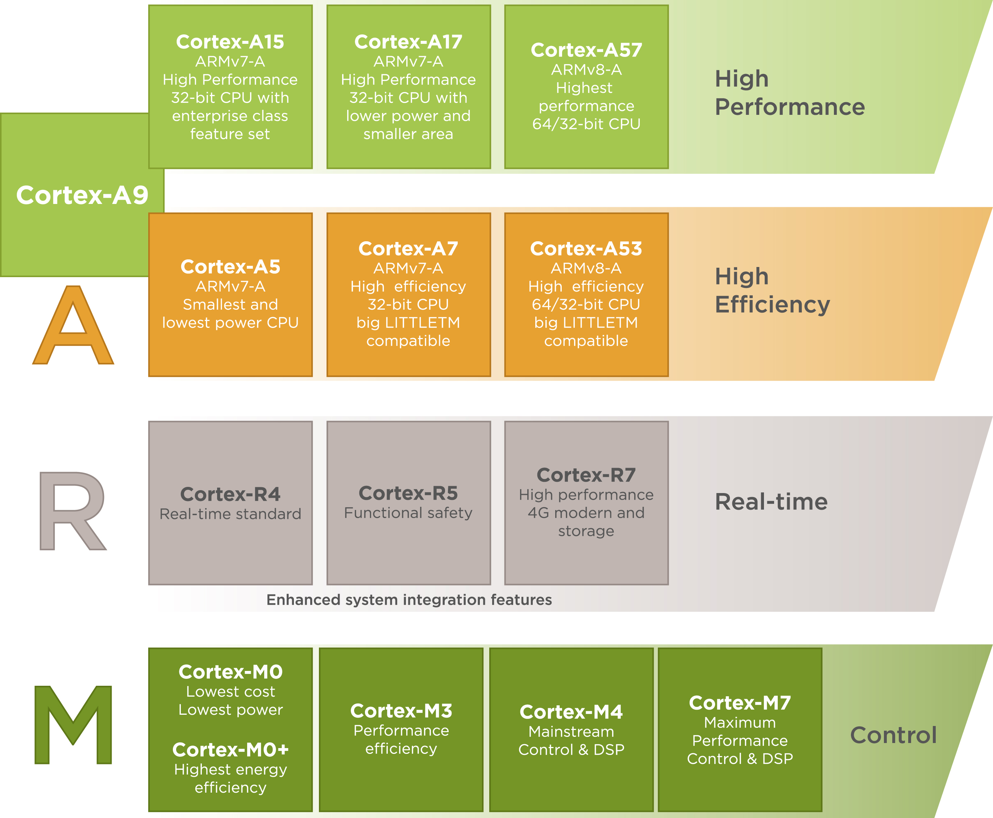
ARM Processor Family

Slide 23
ARM Cortex M family
ARM Cortex-M optional components
ARM Core | Cortex M0^{[2]} | Cortex M0+^{[3]} | Cortex M1^{[4]} | Cortex M3^{[5]} | Cortex M4^{[6]} | Cortex M7^{[7]} | Cortex M23^{[8]} | Cortex M33^{[12]} | Cortex M35P
SysTick 24-bit Timer | Optional (0,1) | Optional (0,1) | Optional (0,1) | Yes (1) | Yes (1) | Yes (1) | Optional (0,1,2) | Yes (1,2) | Yes (1,2)
Single-cycle I/O port | No | Optional | No | No | No | No | Optional | No | No
Bit-Band memory | No^{[13]} | No^{[13]} | No* | Optional | Optional | Optional | No | No | No
Memory Protection Unit (MPU) | No | Optional (0,8) | No | Optional (0,8) | Optional (0,8) | Optional (0,8,16) | Optional (0,4,8,12,16) | Optional (0,4,8,12,16) | Optional *
Security Attribution Unit (SAU) and Stack Limits | No | No | No | No | No | No | Optional (0,4,8) | Optional (0,4,8) | Optional *
Instruction TCM | No | No | Optional | No | No | Optional | No | No | No
Data TCM | No | No | Optional | No | No | Optional | No | No | No
Instruction Cache | No^{[14]} | No^{[14]} | No^{[14]} | No^{[14]} | No^{[14]} | Optional | No | No | Optional
Data Cache | No^{[14]} | No^{[14]} | No^{[14]} | No^{[14]} | No^{[14]} | Optional | No | No | No
Vector Table Offset Register (VTOR) | No | Optional (0,1) | Optional (0,1) | Optional (0,1) | Optional (0,1) | Optional (0,1) | Optional (0,1,2) | Yes (1,2) | Yes (1,2)

Slide 24
ARM-Core Processor

Slide 25
ARM-Core Processor working
The ARM processor, like all RISC processors, uses a load-store architecture. This means it has two instruction types for transferring data in and out of the processor: load instructions copy data from memory to registers in the core, and conversely the store instructions copy data from registers to memory.
Data processing is carried out solely in registers. Data items are placed in the register file (a storage bank made up of 32-bit registers.)
Since the ARM core is a 32-bit processor, most instructions treat the registers as holding signed or unsigned 32-bit values.
The sign extend hardware converts signed 8-bit and 16-bit numbers to 32-bit values as they are read from memory and placed in a register.
ARM instructions typically have two source registers, Rn and Rm, and a single result or destination register, Rd. Source operands are read from the register file using the internal buses A and B, respectively.

Slide 26
ARM-Core Processor working
The ALU (arithmetic logic unit) or MAC (multiply-accumulate unit) takes the register values Rn and Rm from the A and B buses and computes a result.
Data processing instructions write the result in Rd directly to the register file.
Load and store instructions use the ALU to generate an address to be held in the address register and broadcast on the Address bus.
One important feature of the ARM is that register Rm alternatively can be preprocessed in the barrel shifter before it enters the ALU. Together the barrel shifter and ALU can calculate a wide range of expressions and addresses.
After passing through the functional units, the result in Rd is written back to the register file using the Result bus.
For load and store instructions the incrementer updates the address register before the core reads or writes the next register value from or to the next sequential memory location.
The processor continues executing instructions until an exception or interrupt changes the normal execution flow.

Slide 27
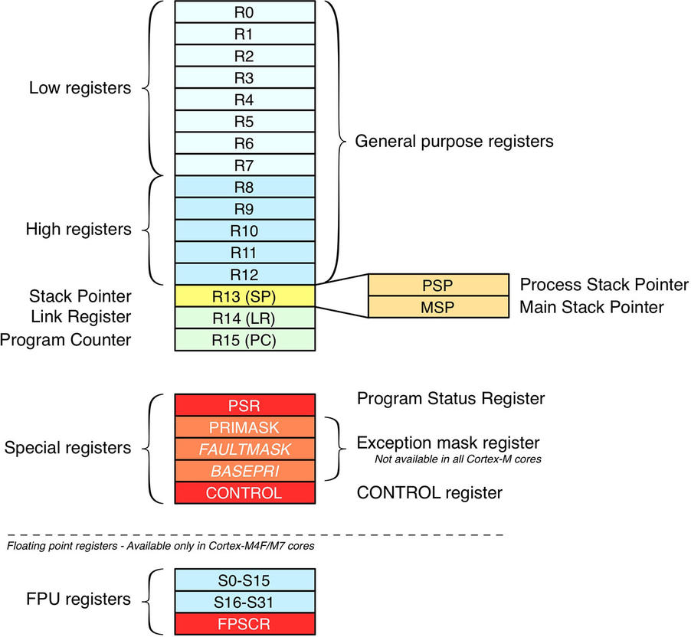
ARM Registers available in user mode(Default Mode)/ Programmers model
CPSR

Slide 28
ARM Registers available in user mode(Default Mode)
The processor can operate in seven different modes, which we will introduce shortly. All the registers shown are 32 bits in size.
There are up to 18 active registers: 16 data registers and 2 processor status registers. The data registers are visible to the programmer as r0 to r15.
The ARM processor has three registers assigned to a particular task or special function: r13, r14, and r15.
Register r13 is traditionally used as the stack pointer (sp) and stores the head of the stack in the current processor mode.
Register r14 is called the link register (lr) and is where the core puts the return address whenever it calls a subroutine.
Register r15 is the program counter (pc) and contains the address of the next instruction to be fetched by the processor.
Note: Depending upon the context, registers r13 and r14 can also be used as general-purpose registers, which can be particularly useful since these registers are banked during a processor mode change.

Slide 29
Current Program Status Register (CPSR)
24
J
N Negative
Z Zero
C Carry
V Overflow
J Jazzle
T Thumb
I Disables **IRQ interrupts when it is set.
F Disables *FIQ interrupts when it is set.
*Fast interrupt request (FIQ), ** interrupt request (IRQ)

Slide 30
Condition mnemonics/OPCODE for transfer program
Put B (Branch) in front of Mnemonics above, for Example BEQ is for branching when value is equal.

Slide 31
ARM MODE and CPSR

Slide 32
Changing mode on an exception
SPSR: Store Program Status Register

Slide 33
ARM Cortex M0+ Architecture Block diagram
ARM-7 Core Processor

Slide 34
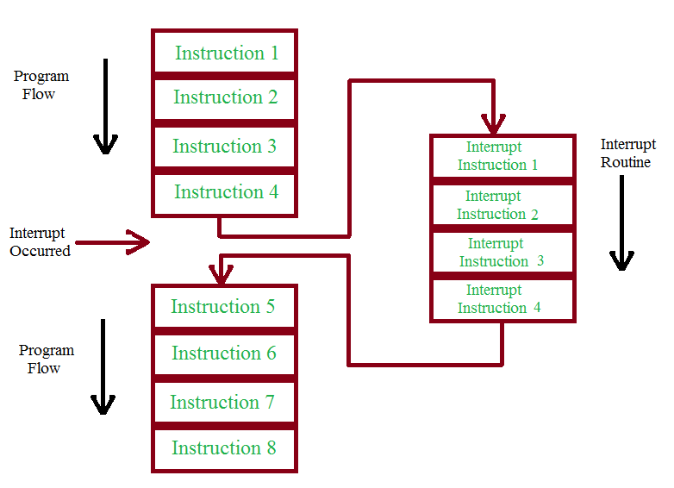
NVIC: Nested Vectored Interrupt Controller
NVIC is an on-chip controller that provides fast and low latency response to interrupt-driven events in ARM Cortex-M MCUs. Along with processing the interrupt, the NVIC also contains a timing module known as SYSTICK timer. This module is used as a reference for the timer and the system (as the name implies) uses this timer for managing its tasks.

Slide 35
Memory model
ARM defines a standardized memory address space common to all Cortex-M cores, which ensures code portability among different silicon manufacturer.
The address space is 4 GB wide (due to 32-bit address line), and it is organized in several subregions with different logical functionalities.
All Cortex-M processors map the code area starting at address 0x00000000. This area also includes the pointer to the beginning of the stack (usually placed in SRAM) and the system interrupt vector table.
An area starting at address 0x08000000 is bound to the internal MCU flash memory, and it is the area where program code resides.
System Memory is a ROM region filled with official pre-programmed Bootloader which can be used to load code from several peripherals, including USARTs, USB and CAN bus.
option Bytes region contains a series of bit flags which can be used to configure several aspects of the MCU (such as flash read protection, hardware watchdog, boot mode and so on).

Slide 36
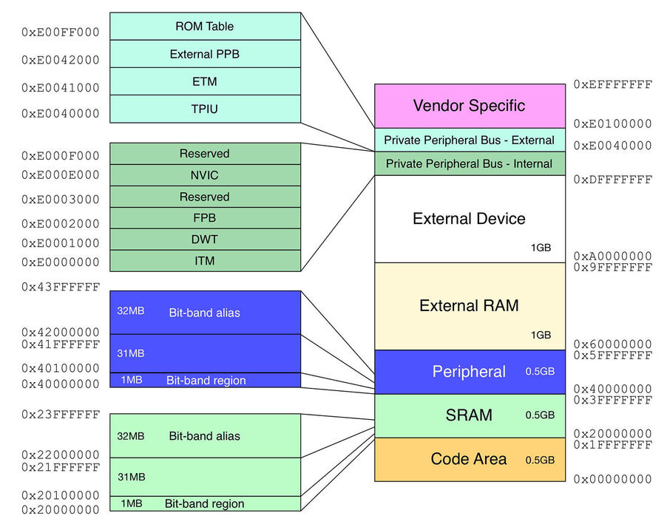
ARM Cortex M0 Memory model

Slide 37
ARM7-Pipeline
A pipeline is the mechanism a RISC processor uses to execute instructions. Using a pipeline speeds up execution by fetching the next instruction while other instructions are being decoded and executed. One way to view the pipeline is to think of it as an automobile assembly line, with each stage carrying out a particular task to manufacture the vehicle.
a three-stage pipeline:
■ Fetch loads an instruction from memory.
■ Decode identifies the instruction to be executed.
■ Execute processes the instruction and writes the result back to a register.

Slide 38
Nomenclature
ARM uses the nomenclature shown in Figure to describe the processor implementations.

Slide 39
ARM Assembly Use NXP:LPC 2148

Slide 40
LPC 2148 of NXP
Features of LPC2148
ARM7TDMI-S based high-performance 32-bit RISC Microcontroller with Thumb extensions
512KB on-chip Flash ROM with In-System Programming (ISP) and In-Application Programming (IAP), 32KB RAM, Vectored Interrupt Controller,
Two 10bit ADCs with 14 channels, USB 2.0 Full Speed Device Controller,
Two UARTs, one with full modem interface.
Two I2C serial interfaces, Two SPI serial interfaces
Two 32-bit timers, Watchdog Timer, PWM unit,
Real Time Clock with optional battery backup,
Brown out detect circuit
General purpose I/O pins.
CPU clock up to 60 MHz, On-chip crystal oscillator and On-chip PLL

Slide 41
ARM Simulator
https://cpulator.01xz.net/?sys=arm

Slide 42
Arm Cortex-M0 Program Image
The Arm Cortex-M0 processor is one of the smallest Arm processors available. The Cortex-M0 has an exceptionally small silicon area, low power and minimal code footprint, enabling developers to achieve 32-bit performance at an 8-bit price point, bypassing the step to 16-bit devices. The ultra-low gate count of the processor enables its deployment in analog and mixed signal devices.

Slide 43
Arm Cortex-M0: specification
Architecture | Armv6-M
Bus Interface | AMBA 3 AHB-Lite, Von Neumann bus architecture
ISA Support | Thumb or Thumb-2 subset
ISA options | Options of single cycle or area optimized 32-x32 multiplier
Pipeline | 3-stages
SysTick timer | Optional SysTick (24-bit)
Interrupts | Integrated Nested Vectored Interrupt Controller (NVIC) supporting 1 to 32 physical interrupts and a Non-maskable Interrupt (NMI). 4 priority levels per interrupt.
Wakeup Interrupt Controller | Optional WIC for waking up the processor from state retention power gating or when all clocks are stopped.
Low Power Support | Architecturally defined Sleep and Deep Sleep Modes Integrated WFI and WFE Instructions and Sleep-On-Exit capability. Sleep and Deep Sleep indication signals. Optional Retention Mode with Arm Power Management Kit.
Debug | Optional JTAG and Serial Wire Debug ports. Up to 4 Breakpoints and 2 Watchpoints

Slide 44
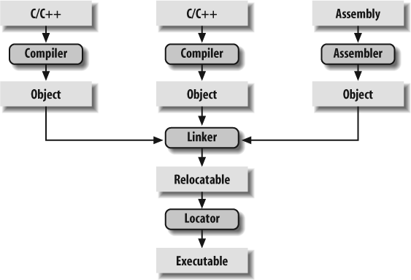
Program-Generation Flow

Slide 45
Compiling
The job of a compiler is mainly to translate programs written in some human-readable language into an equivalent set of opcodes for a particular processor. In that sense, an assembler is also a compiler (you might call it an “assembly language compiler”), but one that performs a much simpler one-to-one translation from one line of human-readable mnemonics to the equivalent opcode. Everything in this section applies equally to compilers and assemblers. Together these tools make up the first step of the embedded software build process.

Slide 46
Linking
.
All of the object files resulting from the compilation in step one must be combined. The object files themselves are individually incomplete, most notably in that some of the internal variable and function references have not yet been resolved. The job of the linker is to combine these object files and, in the process, to resolve all of the unresolved symbols.
The output of the linker is a new object file that contains all of the code and data from the input object files and is in the same object file format. It does this by merging the text, data, and bss sections of the input files. When the linker is finished executing, all of the machine language code from all of the input object files will be in the text section of the new file, and all of the initialized and uninitialized variables will reside in the new data and bss sections, respectively

Slide 47
Locating
The tool that performs the conversion from relocatable program to executable binary image is called a locator. It takes responsibility for the easiest step of the build process. In fact, you have to do most of the work in this step yourself, by providing information about the memory on the target board as input to the locator.
The locator uses this information to assign physical memory addresses to each of the code and data sections within the relocatable program. It then produces an output file that contains a binary memory image that can be loaded into the target.

Slide 48
ARM Program Data

Slide 49
ARM Program Data
armclang:
Is built on modern LLVM and Clang technology
Supports GNU syntax assembly
Is highly compatible with source code originally written for GCC
Implements specifications including ANSI/ISO C and C++, ABI for the Arm architecture, ABI for the 64-bit Arm architecture, and Arm C Language Extensions (ACLE)
armlink: Feature-rich dedicated embedded linker that combines objects and libraries to produce an executable
Arm C libraries: Optimized by Arm for performance and code density, and include the tiny MicroLib for deeply embedded applications.
Arm C++ libraries: Libraries based on the LLVM libc++ project
fromelf: Image conversion utility and disassembler
armar: Archiver that enables sets of object files to be collected together
*The LLVM Project is a collection of modular and reusable compiler and toolchain technologies. Despite its name, LLVM has little to do with traditional virtual machines. The name "LLVM" itself is not an acronym

Slide 50
Cortex-M0+ Program Image
The Executable generated after the linker is the final program image. The linker script file instructs the GNU linker to locate the data, bss, and text sections in RAM starting at address 0x20000000.
The first executable instruction is designated with the ENTRY command, which appears on the first line of the preceding example. In this case, the entry point is the function main.

Slide 51
Data Types in ARM
Normal Mode data: 32 bit
Thumb Mode Data:16 bit
Jazelle Mode data: 8 bit

Slide 52
Sample MCQ
1). What is the standard form of ARM?
Advanced RISC Machine
Automatic RISC Machine
Automatic RISC Motor
None of the above
2). How many instruction sets does ARM have?
One
Two
Three
Four
3). How many registers does ARM have?
Four
Eight
Sixteen
Thirty-seven
4). How many operating modes does ARM have?
Four
Seven
Sixteen
Thirty-seven
5). How many arithmetic shift operators does ARM have?
One
Two
Three
Four
6). What is the standard form of LSL?
Logical Shift Left
Left Shift Logical
Logical Shift Logic
7). When the processor is executing in ARM state, then all instructions are ______________ wide.
8-bits
16-bits
32-bits
64-bits

Slide 53
Thank You

